Slide 1


PDF Fault Detection and Cleaning using Multiclass Classification Model
- Ankita Anuradha

Slide 2


Problem Statement
PDF files frequently include blank or corrupted pages that can disrupt data extraction, increase storage size, and reduce document clarity. In large scale document processing, manually identifying such pages is inefficient.

Slide 3
Solution
PDF Fault Detection model automates the detection and removal of blank and corrupted pages from PDFs using a deep learning-based image classification that can be integrated into websites/webapps such as Streamlit webapp, which has been implemented in this project to detect the faulty pages, remove them and download the clean document.
The objectives are:
To collect real life dataset for training & testing and build a model to accurately detect fault in the PDF
To integrate the model into web application and making it user friendly.

Slide 4
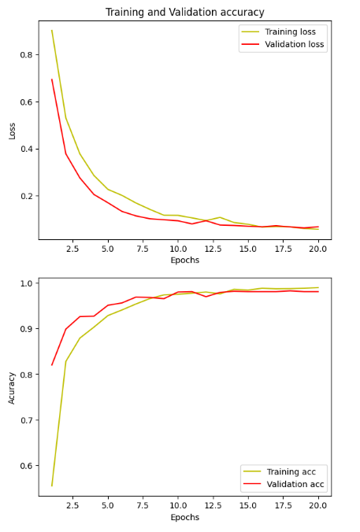
Dataset Used:
Evaluation
1. Corrupted: 1224 images Includes noisy, blurred, misaligned scans. Label 2
2. Non-blank: 2486 images Includes scans of invoices. Label 1
3. Blank: 1186 images that are completely blank. Label 0
Processing:
Each image was resized to a uniform shape of 150x150 pixels and normalized by scaling pixel values between 0 and 1. Labels were encoded using one-hot encoding to make them suitable for multi-class classification. The data was then split into training and testing sets using an 80:25 ratio
Model Architecture:
The classification model was built using a Convolutional Neural Network (CNN) implemented with TensorFlow and Keras. Multiclass classification was used by providing labels to the images. he model was compiled using the Adam optimizer with a learning rate of 0.0001 and categorical crossentropy loss. The architecture was designed to maximize validation accuracy and achieved competitive performance in detecting blank and corrupted pages.

Slide 5
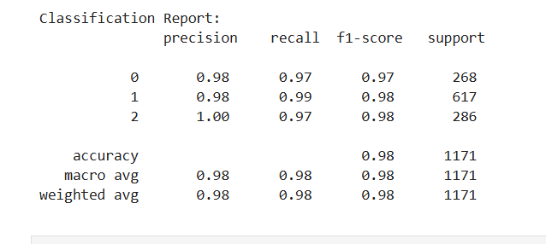
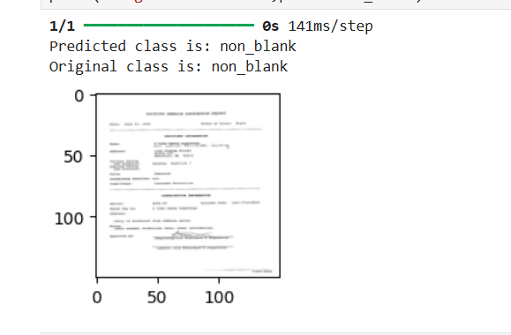
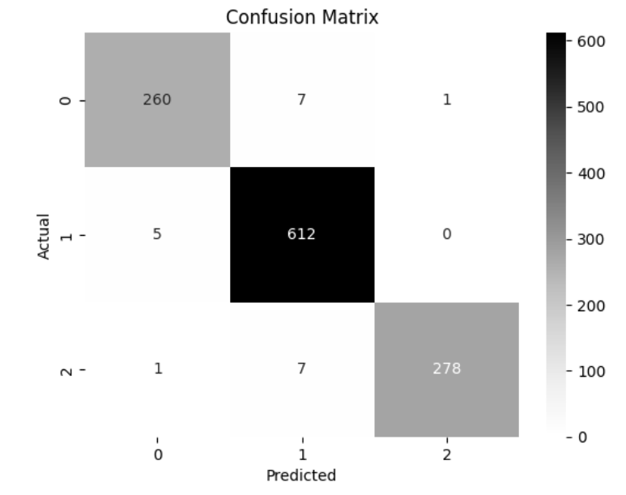
Results
Classification report of the model
Both the accuracy and the validation accuracy of this model is 98.2%. As shown in the above image, the prediction class matches with the original class, that is, the model can accurately recognize which class a given image belongs to.
Plot of confusion matrix for the model.

Slide 6
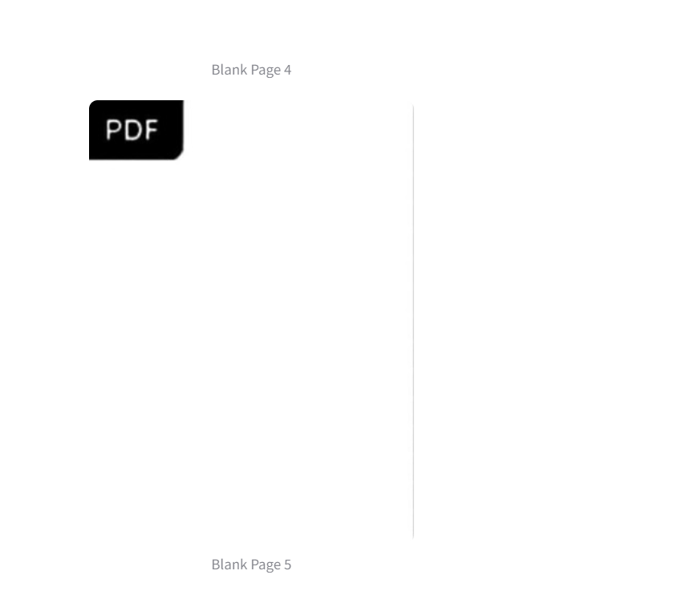
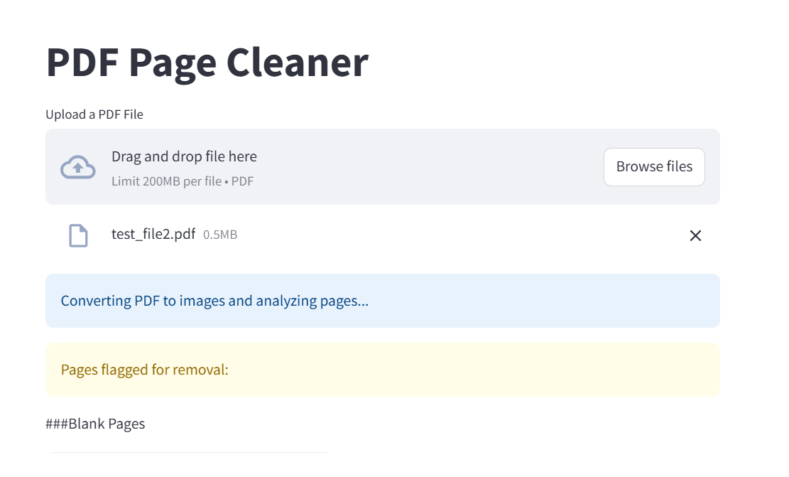
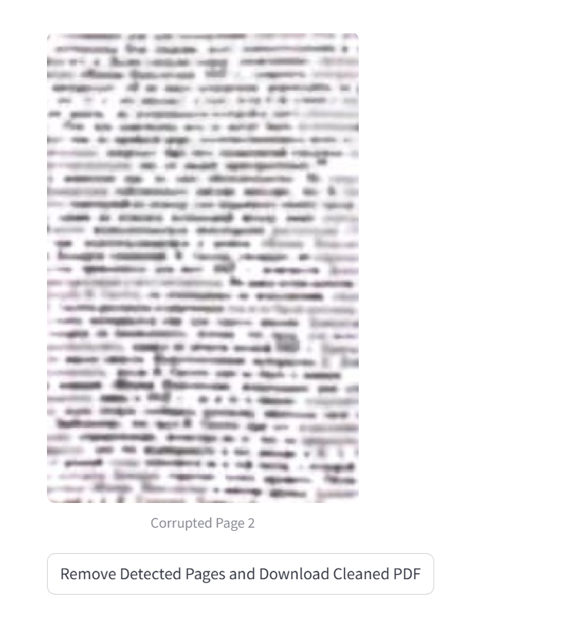
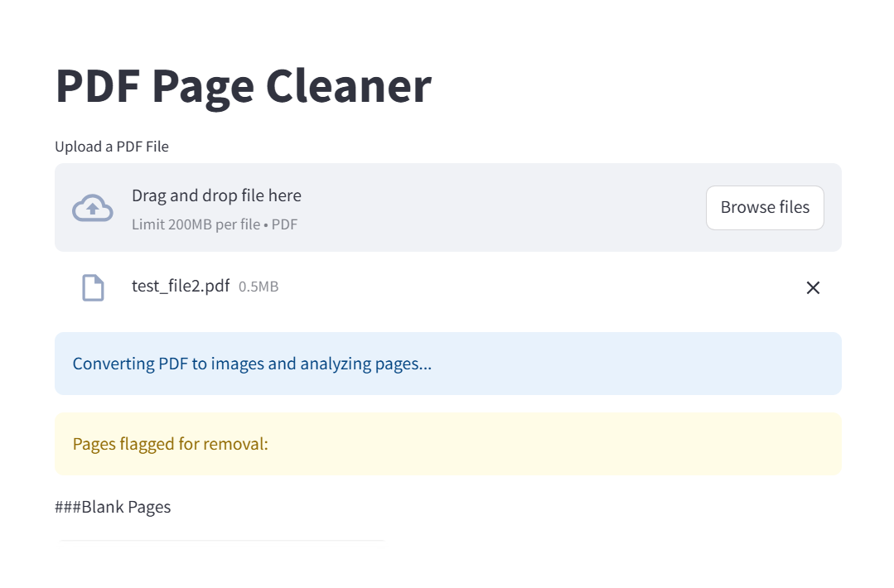
The model was integrated into a Streamlit Webapp.
As shown in the images, the user uploads the document. The pdf is converted to images that can be analyzed and then the app flags the pages that are either blank or corrupted.
The user can also verify as the app shows the pages that are corrupted.
After verification, the user can remove the flagged pages and download the clean pages.

Slide 7
Improvements and Conclusion
The current dataset is still too small and needs more real life images and examples. Expanding the dataset to include more diverse samples, such as partially scanned pages, low-resolution documents, or multilingual content, could improve the model’s generalizability. Using data augmentation techniques like adaptive noise injection, distortion, or skewing could also help make the model more robust. More complex architecture with a better dataset would make the model more efficient.
This project successfully automates the detection and removal of blank and corrupted pages from PDF documents. A custom multi-class image classification model was built and deployed through a Streamlit web application, allowing users to upload PDFs, visually verify problematic pages, and download a cleaned version. The model achieved high accuracy and proved effective across various document types and strong potential for integration into larger document management systems.

